Slide 1
RadioLogic
a case-based learning and self-assessment tool for the Orthanc Ecosystem for Medical Imaging
Marco Barnig

Slide 2
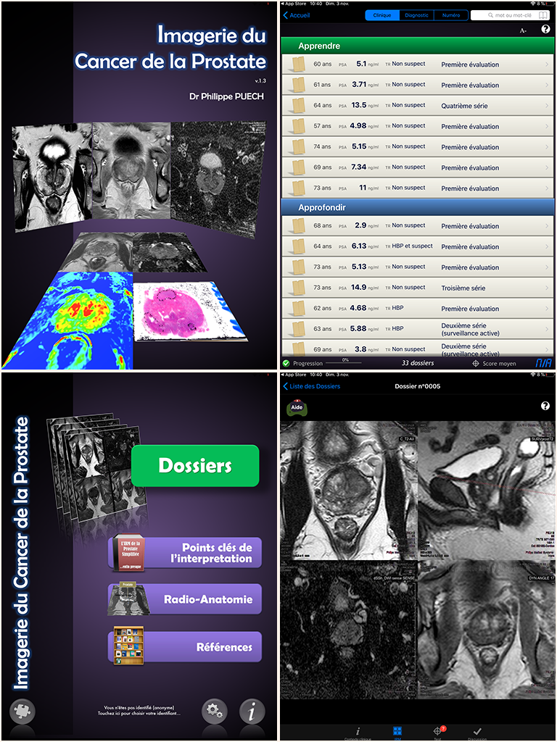
1. Introduction
A few years ago, my son in law, Guillaume Bierry, who is professor of radiology at the university hospital in Strasbourg, asked me if I could create a teaching tool for medical students, based on real clinical cases
Reference : application about prostate cancer imaging developed by professor Philippe Puech from Lille
Case-based learning is an efficient method for radiologist education
Wanted : Tool including a real DICOM viewer to visualize whole medical imaging studies
Challenge : OFUR (outil de formation universitaire radiologique)

Slide 3
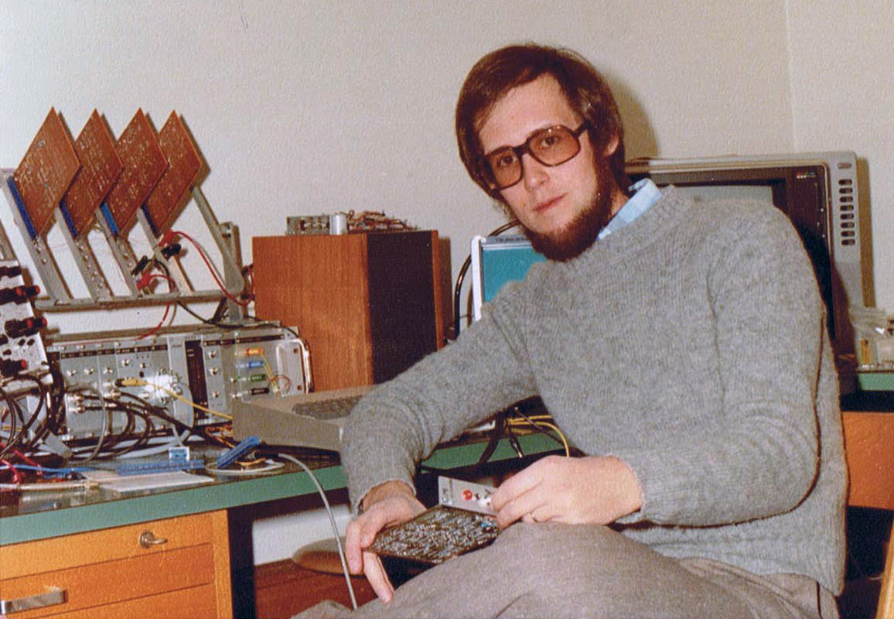
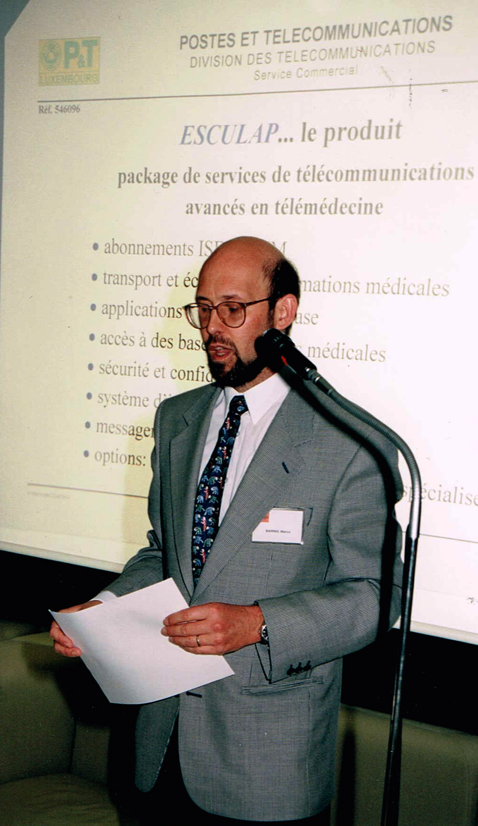
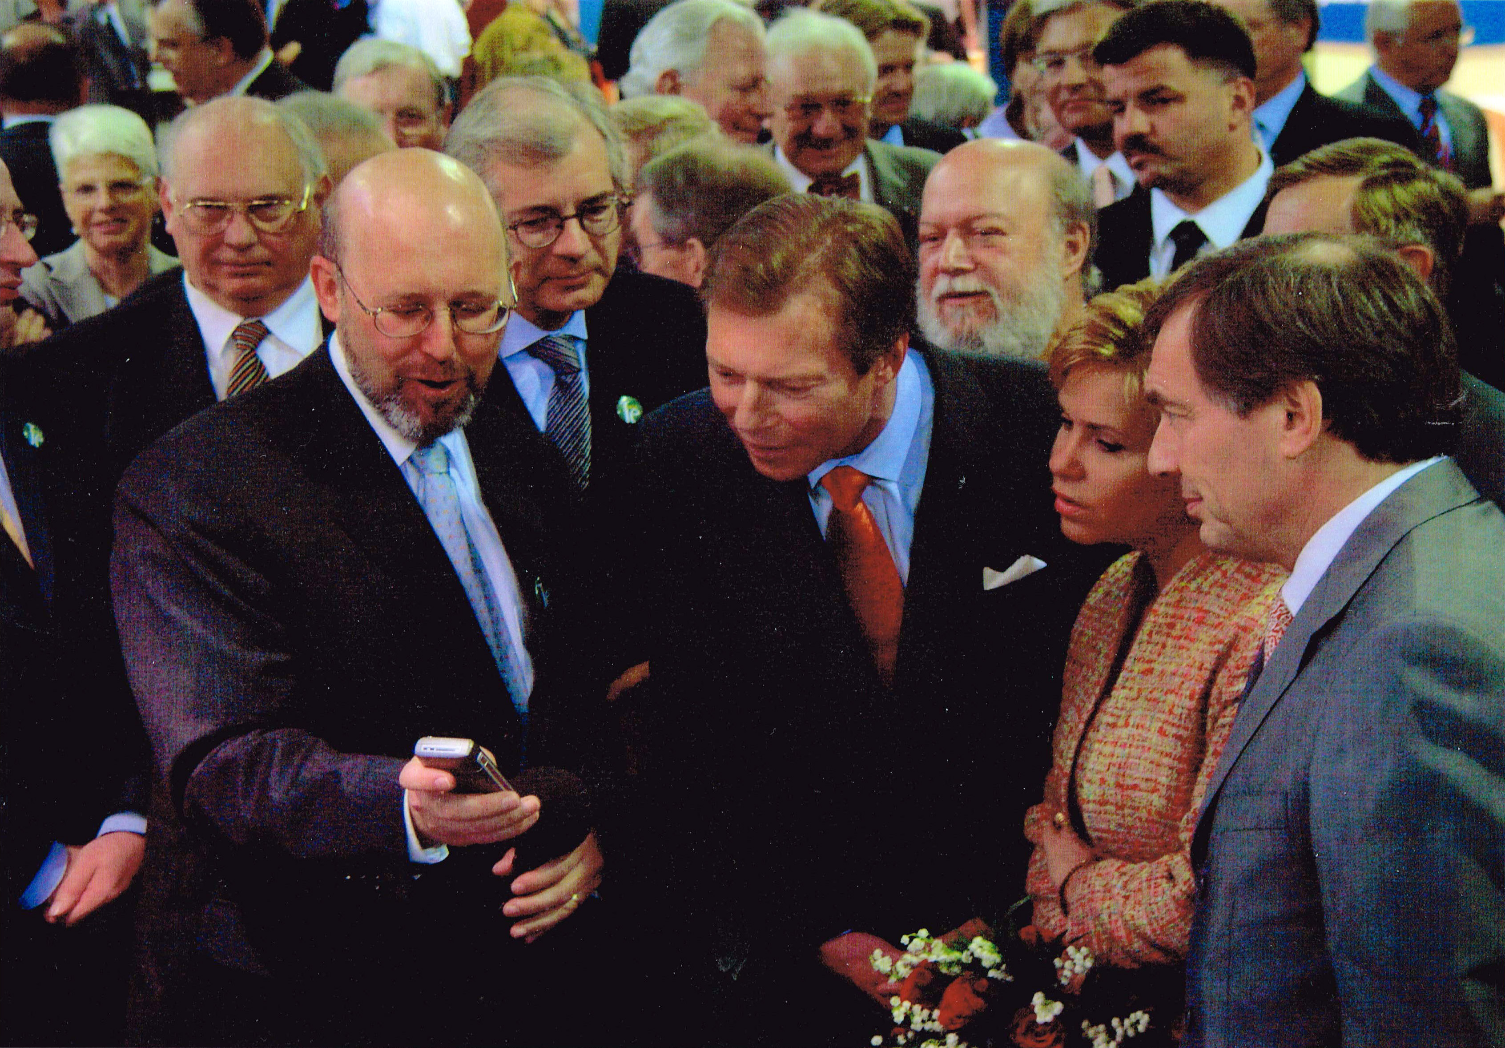
2. My background
1974: research assistant at the Federal Institute of Technology in Zurich > first microprocessor Intel 4004
1978: POST Luxembourg > new telecommunication services : Alarmis, Euronet, Luxpac, Videotex, ISDN, LUXGSM, Internet
1993: responsible for sales and marketing of all telecommunications services
1998: first personal website
2013: retirement > time, experience, hardware, independence

Slide 4
3. OFUR
Orthanc as PACS
Cornerstone or DWV as HTML viewer
Focus on iPAD and Mac
3 targets : students, radiologists, MD
3 products : OFUR-chu, -lite, -pro
Interface language : English
License: open-source
No medical certification
Comply with data protection rules
Project development : 5 steps
Development duration : 12 months
Project hosting : Amazon Web Services
Personal assessment facilities
Usage without Internet access
Low costs
Mid 2015 : first prototype of OFUR-lite, based on the Cornerstone framework

Slide 5
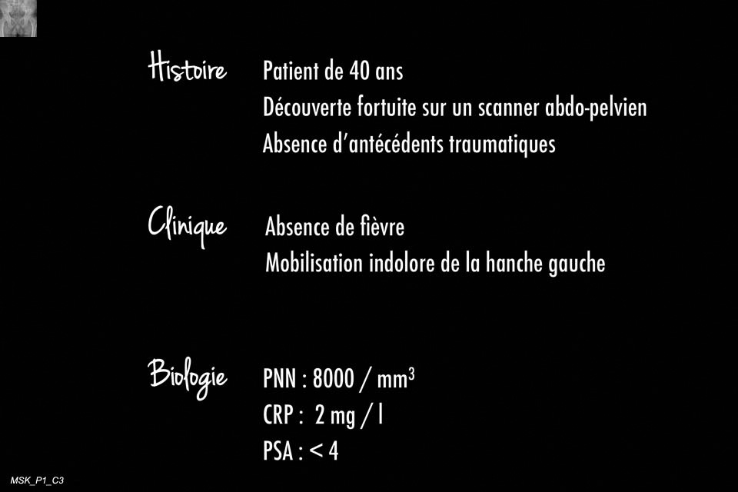
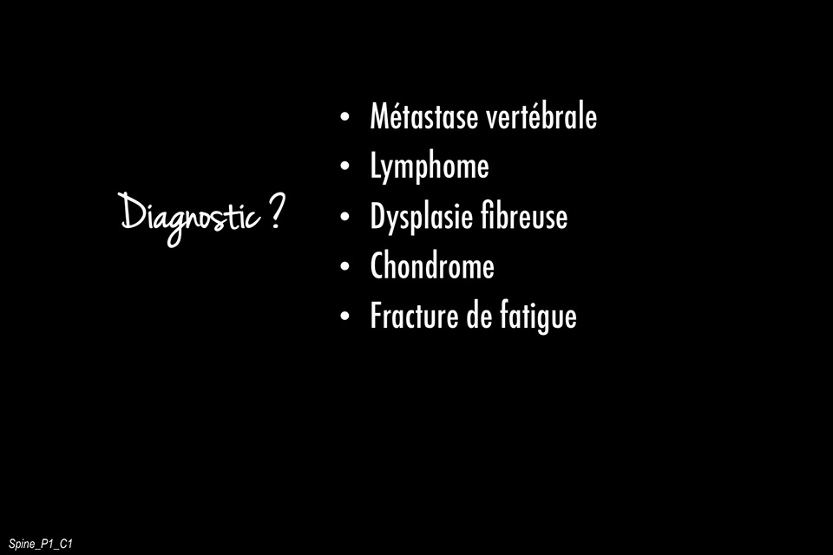
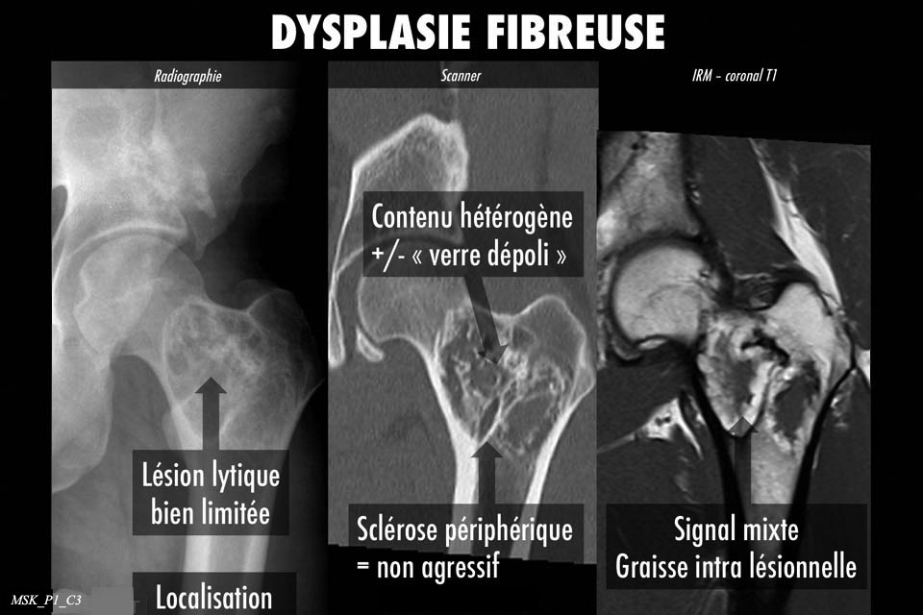
4. Clinical cases
August 2015: tests with first clinical case
Issues:
The download time was high
Large CR files could not be handled on iPAD’s
The cornerstone framework supported only ASCII characters
CORS was required to make requests across domain boundaries
The DICOM files for the clinical cases and the integration of the pictures in DICOM files were assembled with Osirix
MSK session with 5 clinical cases
SPINE session with 3 clinical cases

Slide 6
5. DICOM is easy
To solve the mentioned issues, it was necessary to dive deeper into the DICOM standard:
Open-source toolkit DCMTK provided by OFFIS e.V. from Germany
GDCM, an implementation of the DICOM standard developed by Mathieu Malaterre
Dicom3tools package created by David A. Clunie
DVTk editor and other DICOM tools
Roni Zaharia, CEO of H.R.Z. Software Services LTD, maintains a blog "DICOM is easy“, including an outstanding tutorial about DICOM. For me DICOM was not easy, but a nightmare.
Despite the steep learning curve, I gradually got the necessary knowledge to manually process the DICOM files to reduce their size by compressing and scaling the images. I learned how to manage private tags to save information about the possible and correct diagnoses. I forked Chris Hafey’s DicomParser to support UTF8 characters. To enable CORS I added a reversed proxy (nginx) to the Orthanc server.

Slide 7
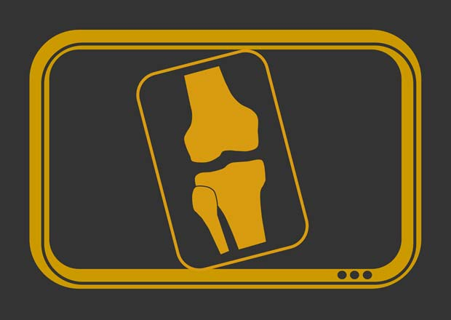
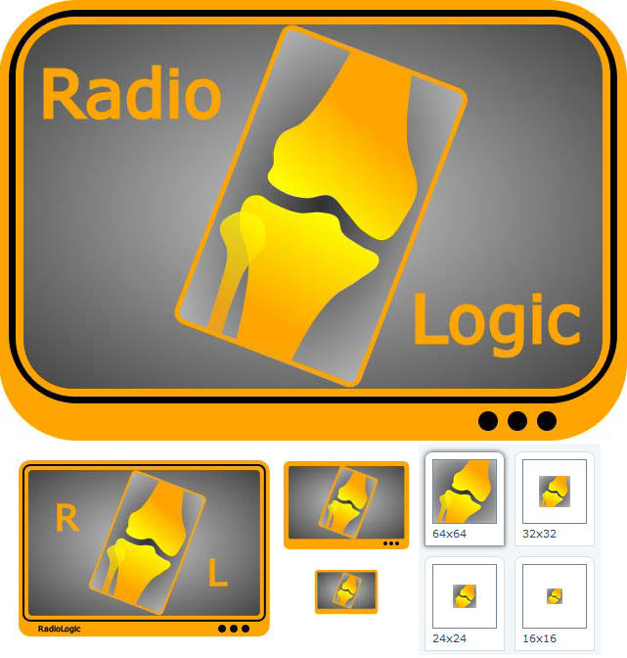
6. Name & Logo
All the blocking issues were solved at the end of 2015:
Decision to progress with the project
Choice of a definitive name
Design of a logo
Early 2016:
Final project name > RadioLogic
Logo > old-fashioned x-ray film viewer
Domain name > radiologic.fr
Website > hosting at AWS

Slide 8
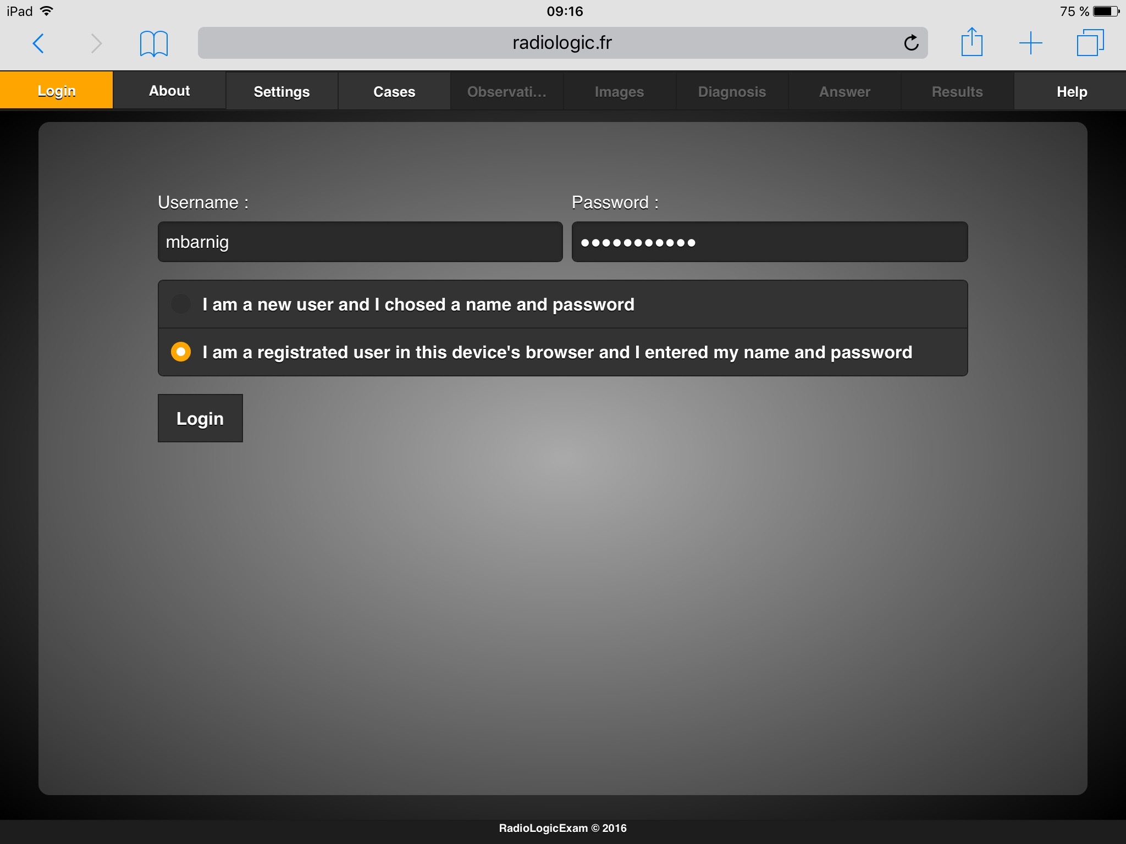
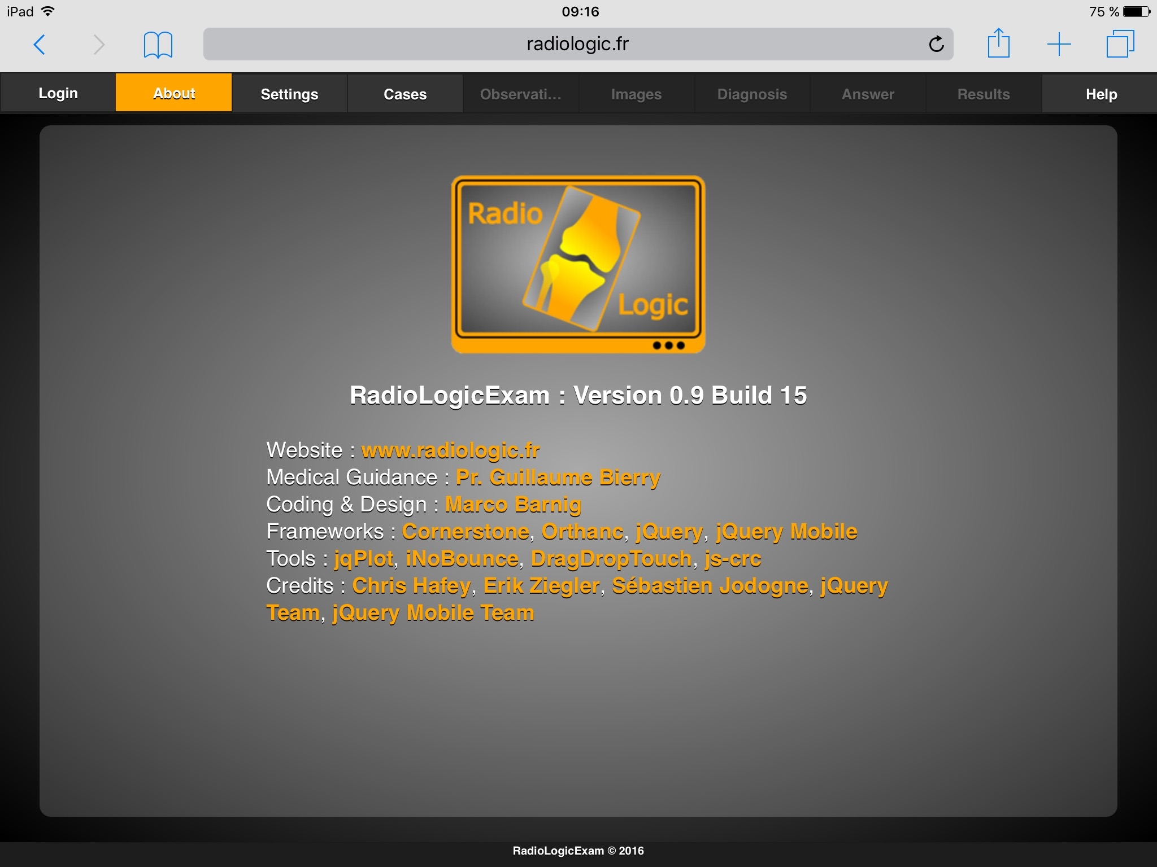
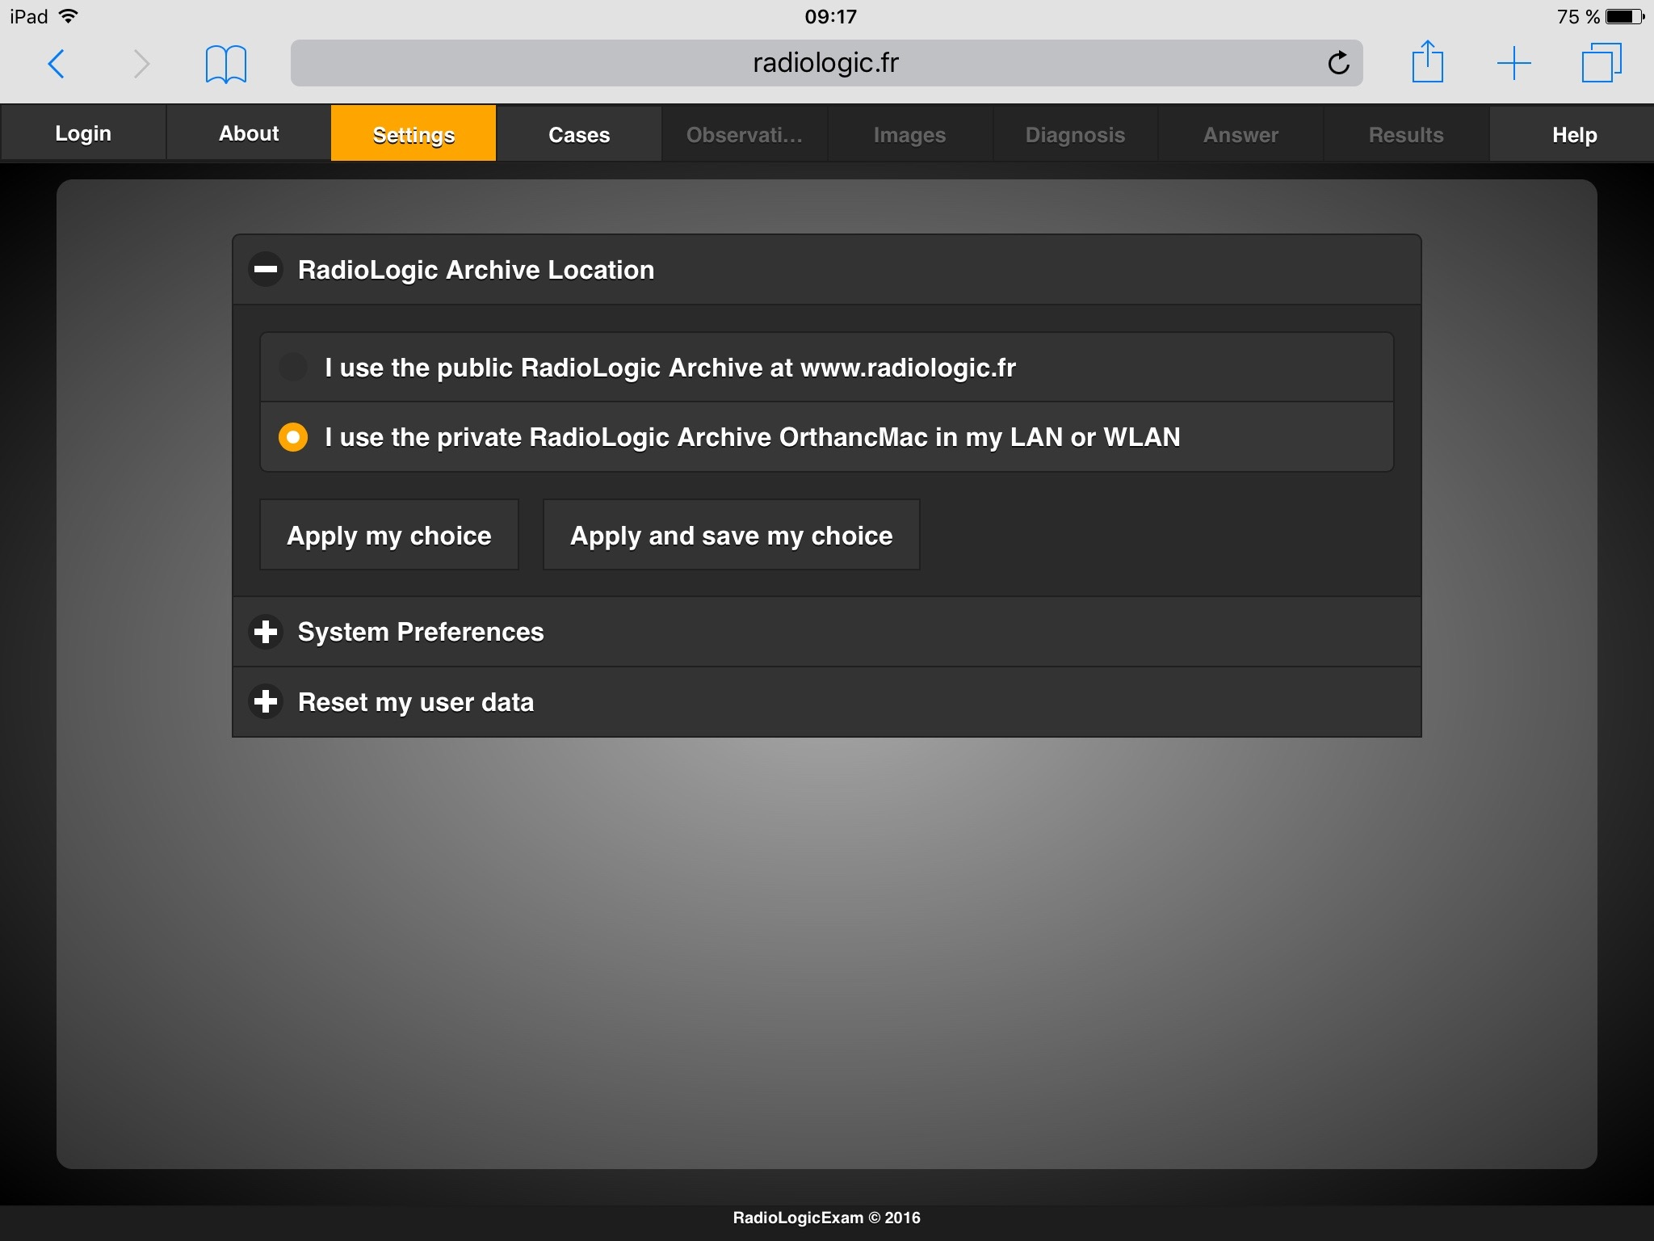
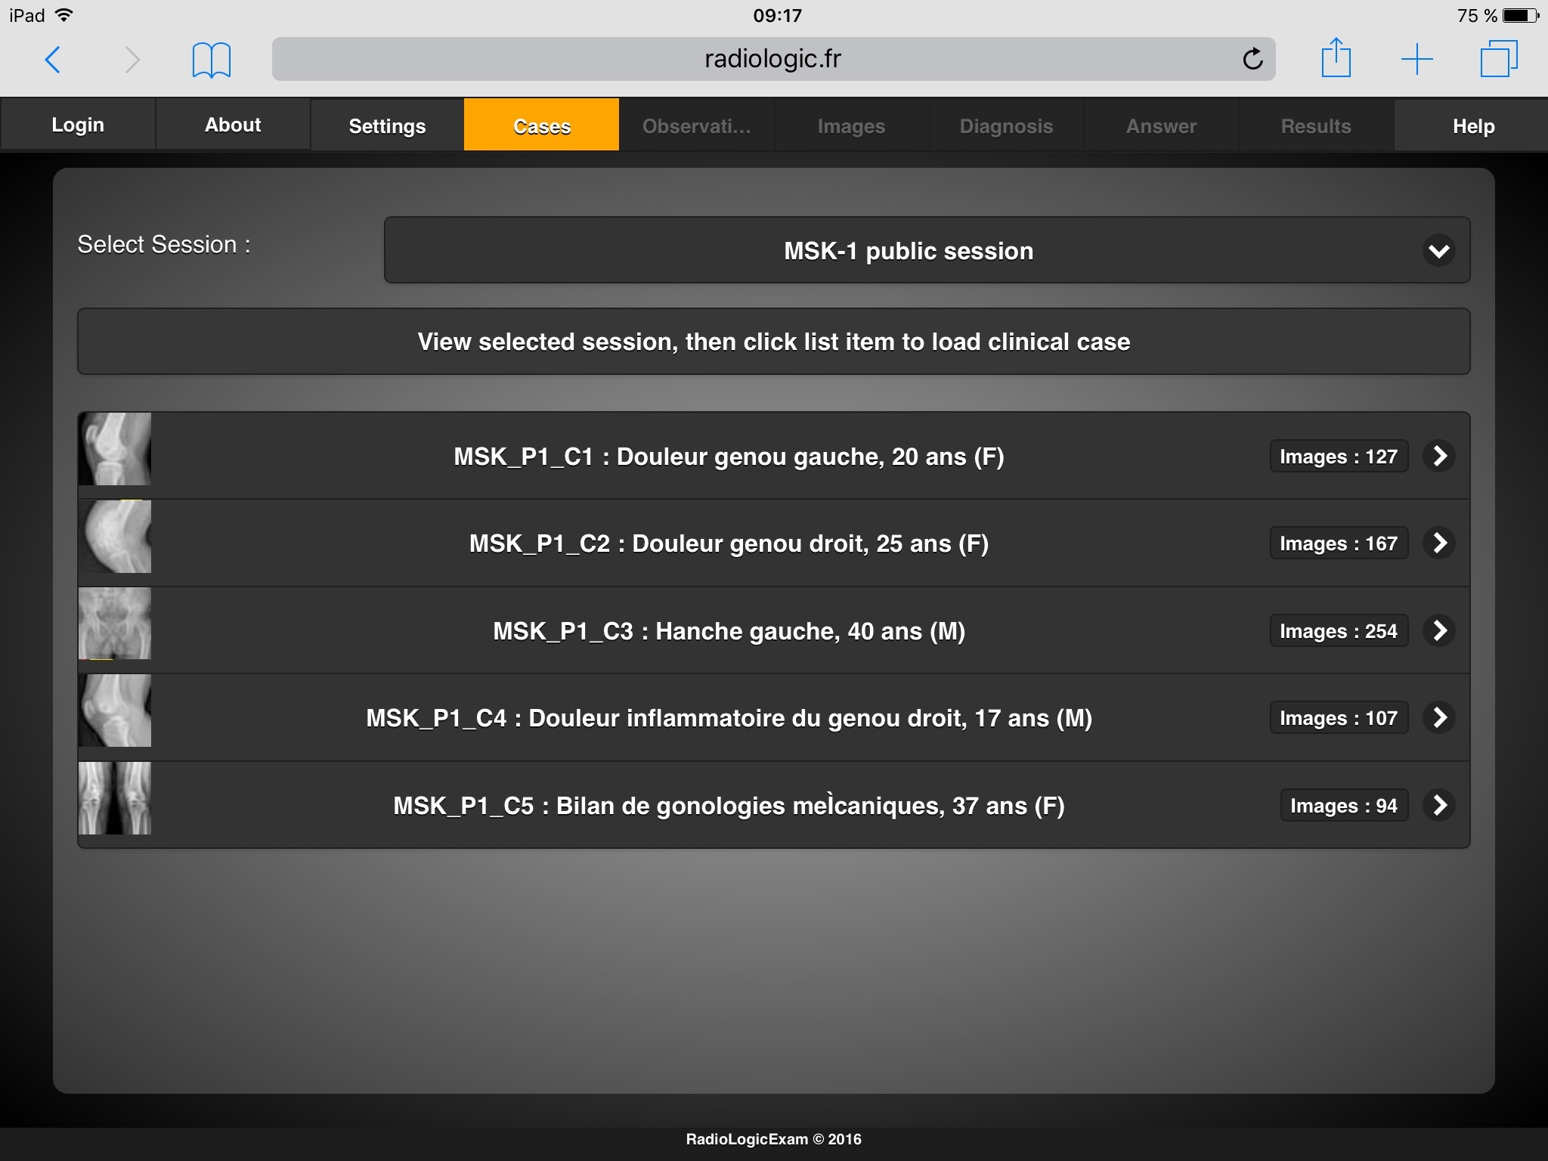
7. RadioLogicTutor I
A stable version of the RadioLogic viewer, called RadioLogicTutor, was ready in mid-2016.
Login/Logout > ID and pw saved inside browser
About > credits
Settings > Orthanc location, system preferences
Cases > choice of session and clinical case

Slide 9
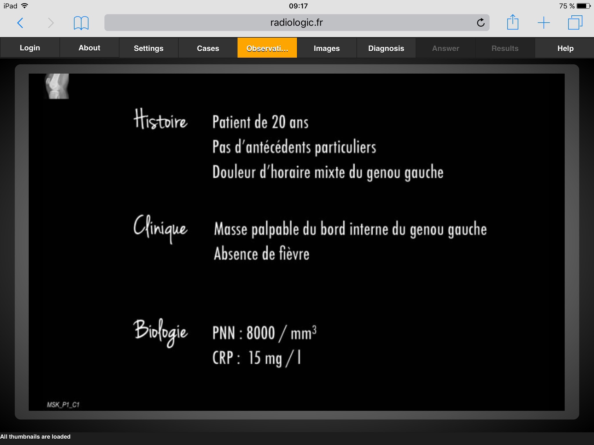
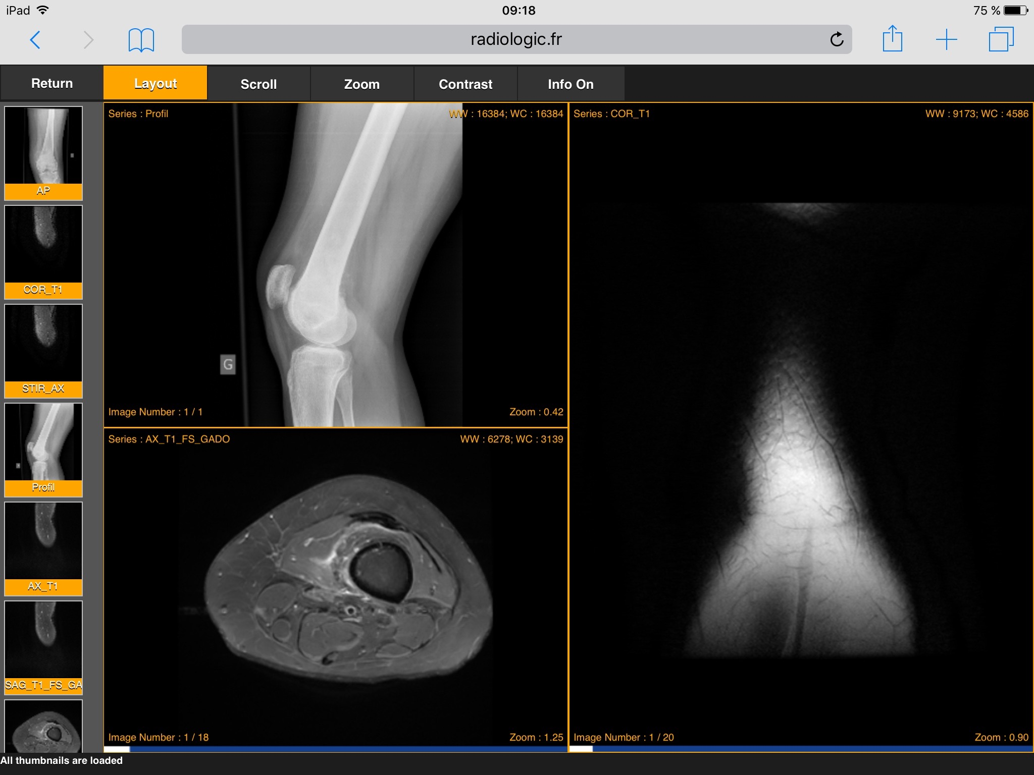
8. RadioLogicTutor II
5. Observation > clinical data about the patient with free text in a grey/color image
6. Images > four viewports, thumbnails-bar for DICOM series, drag and drop

Slide 10
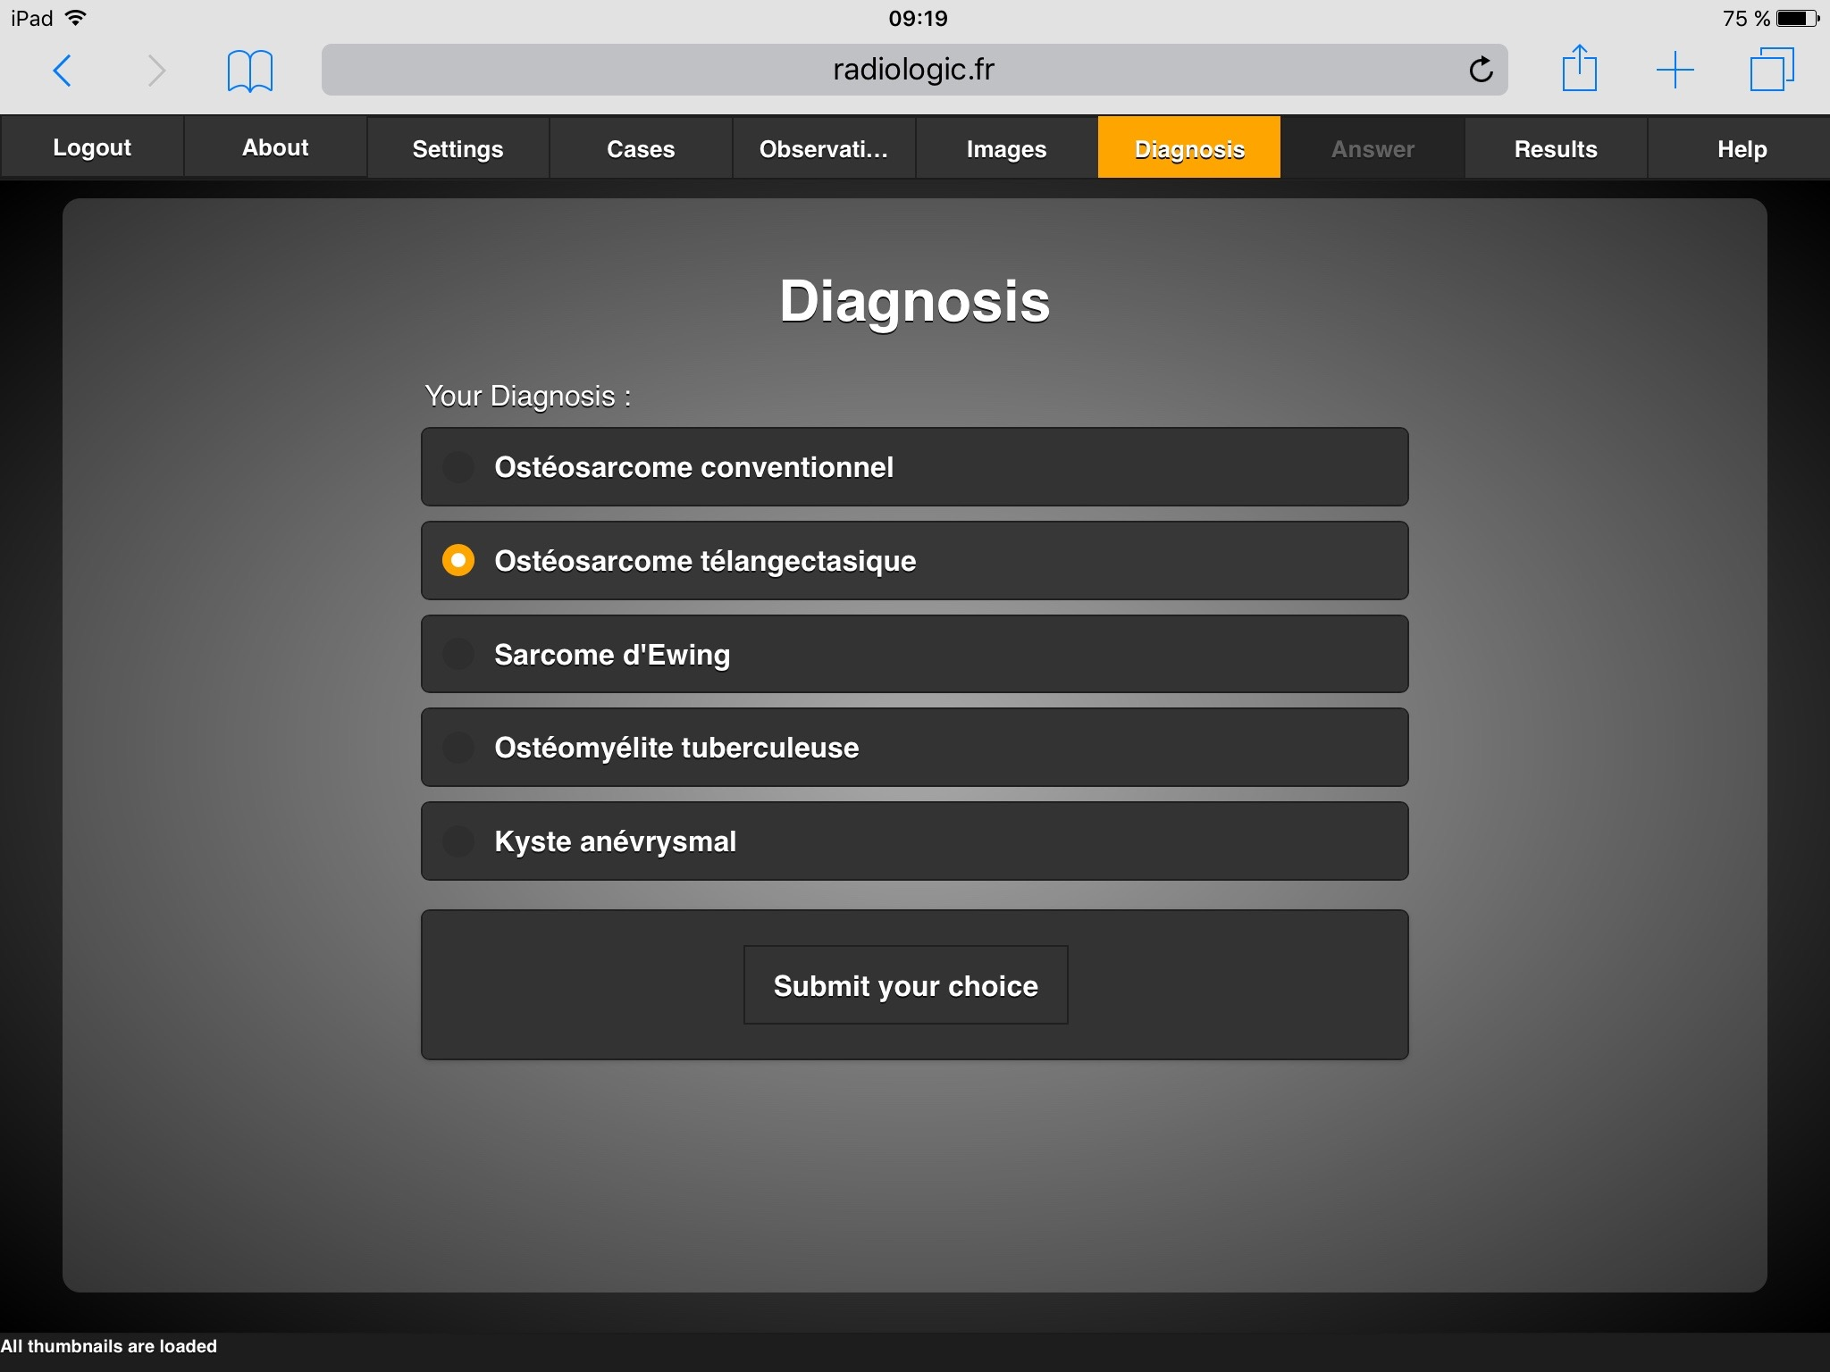
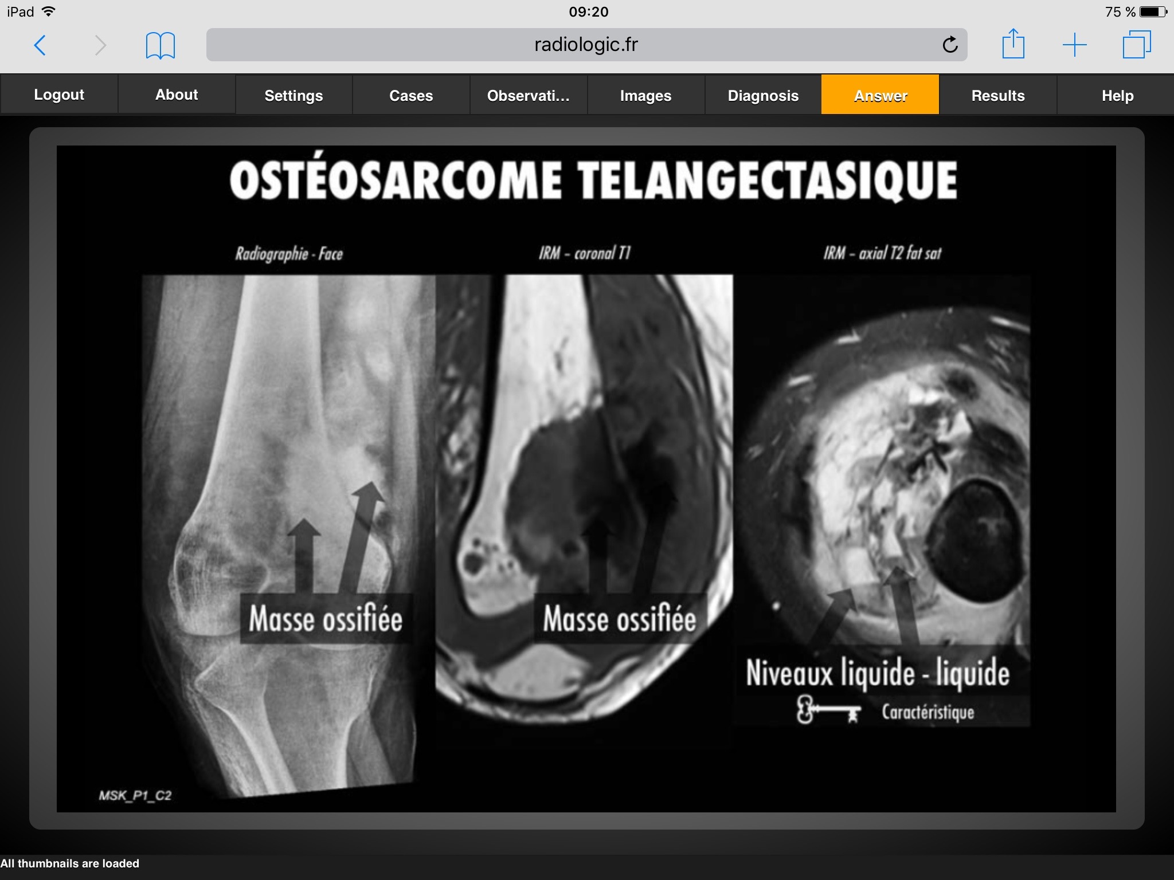
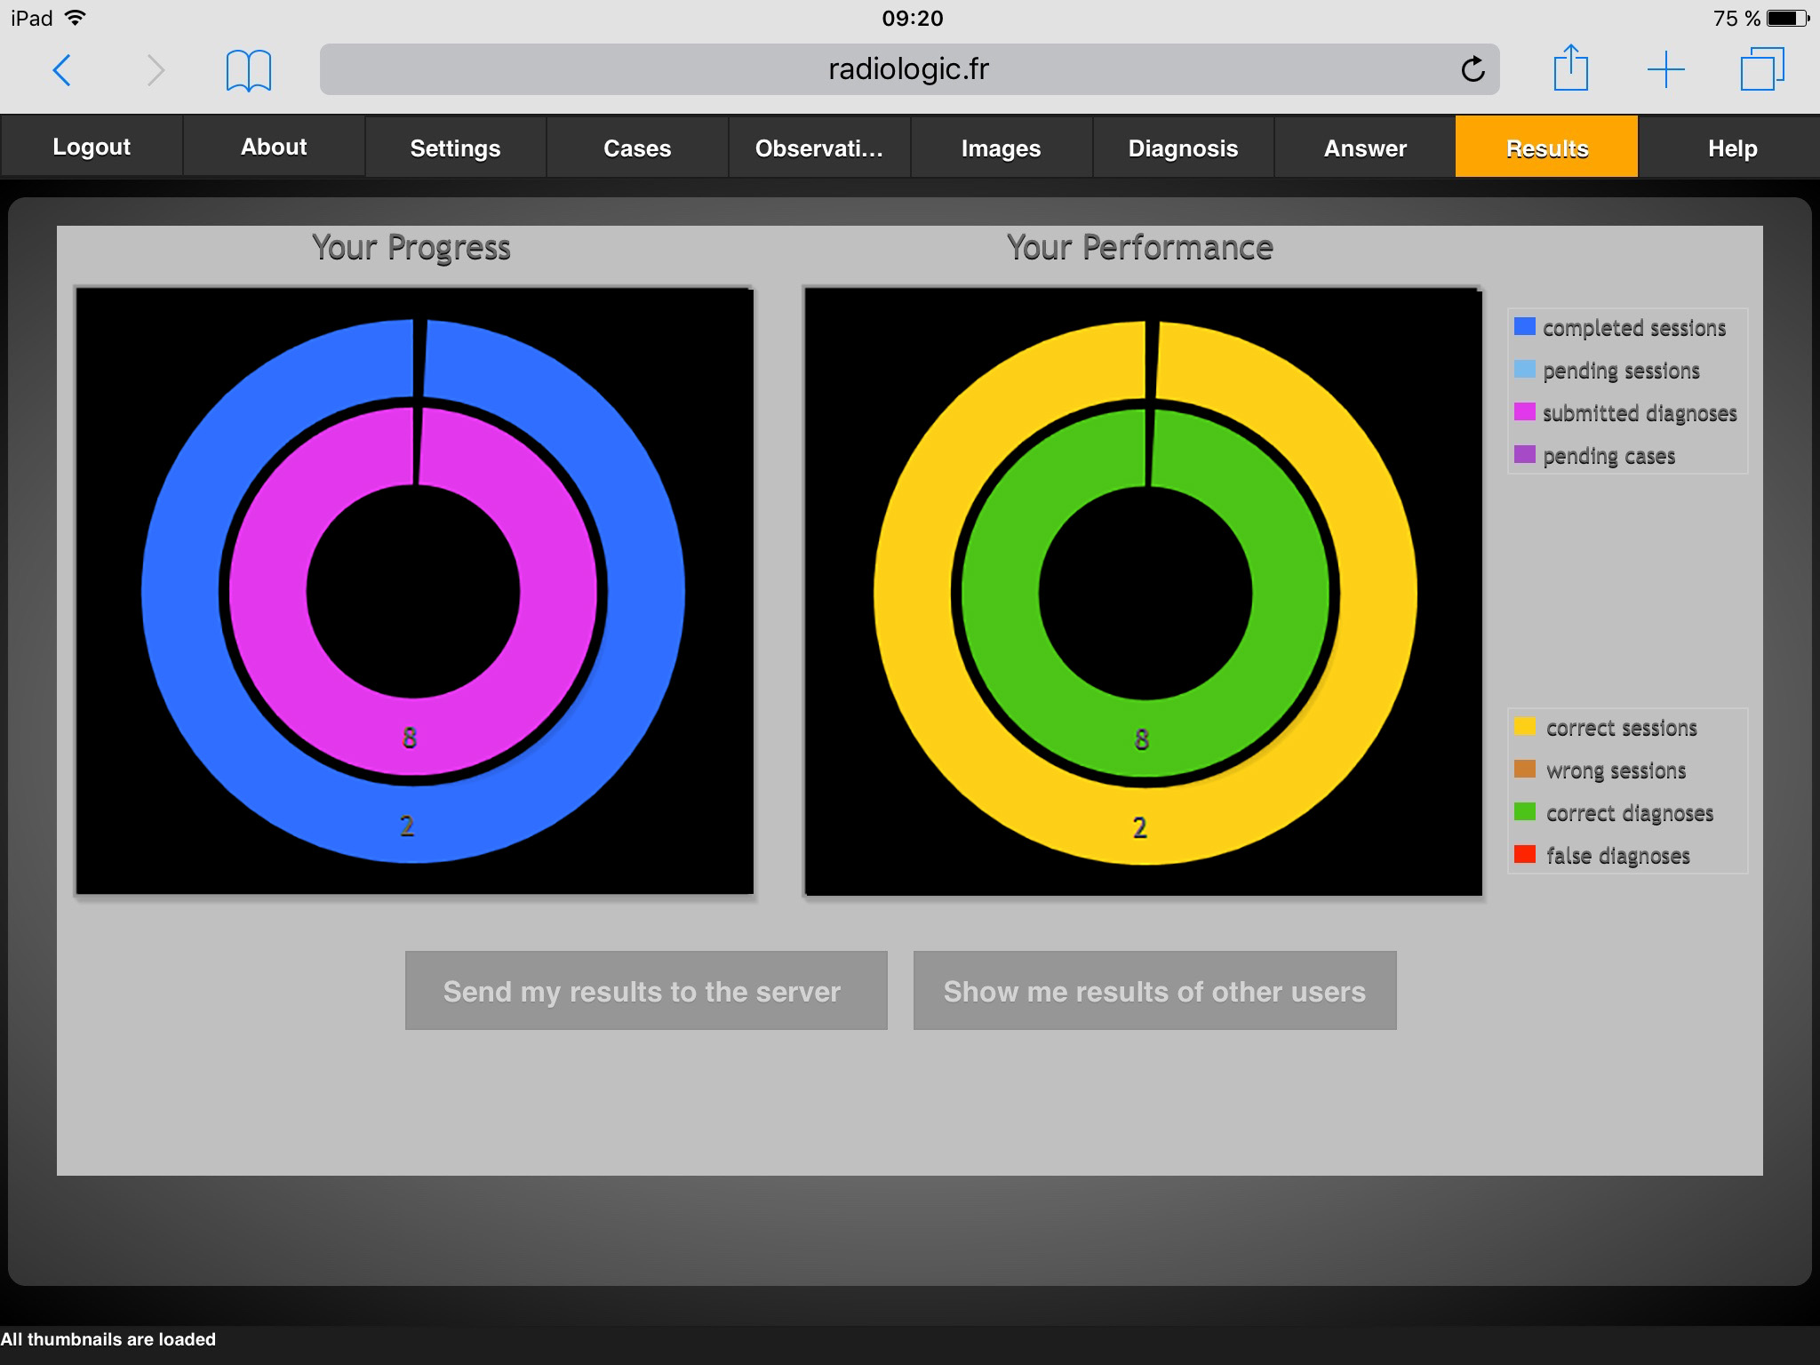
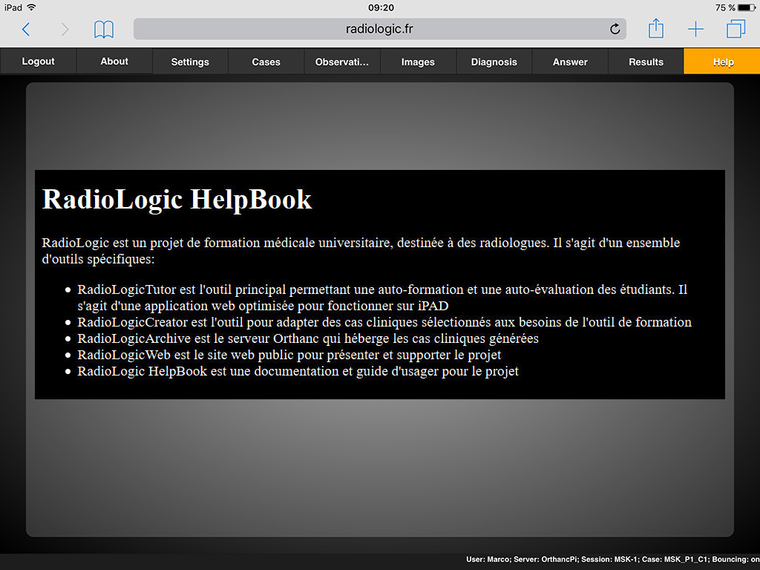
9. RadioLogicTutor III
7. Diagnosis > multiple choice radio-buttons, submission
8. Answer > grey or color image explaining the correct diagnoses with free text and pictures
9. Results > user progress and performance in graphical form (assessment), comparison with peers
10. Help > hints and info how to use the application

Slide 11
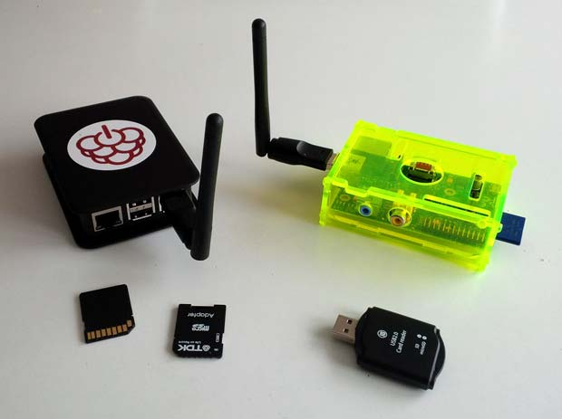
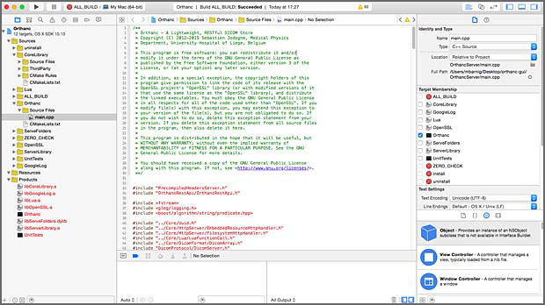
10. OrthancPi & OrthancMac
Early 2016, I ported the Orthanc source code to the Raspberry Pi, a credit-card–sized single-board computer
Proof of concept
Tests with models B Pi1, Pi2 and Pi3 and different WiFi adapters
In parallel, I compiled the Orthanc source code for OS X
MacBook as DICOM archive
OS X El Capitan

Slide 12
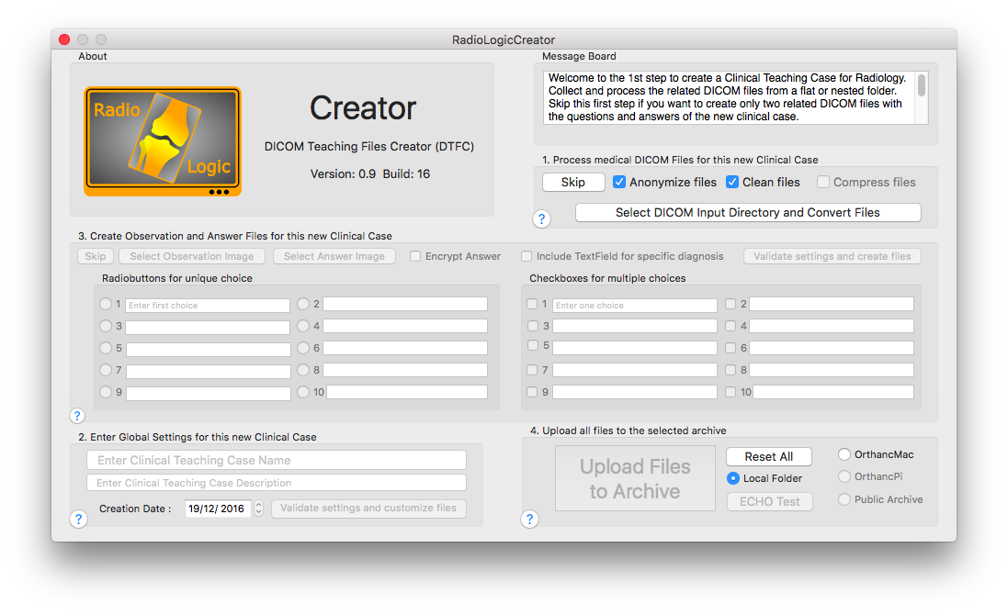
11. RadioLogicCreator on Mac I
Assembling, processing and checking selected DICOM files manually with a half-dozen different tools to create clinical cases was cumbersome and not error-proof
Mid 2016: tool to automate the process on Mac
C, C++, Objective-C or Swift 3
Experience with Java, PHP, Python, Javascript
Four steps: compression & scaling, customization, private tags, uploading
End 2016 : 1st stable version

Slide 13
12. RadioLogicCreator on Mac II
The RadioLogicCreator tool running on Mac was a continuous source of frustration for the users and the developer, for the following reasons:
Deployment was difficult due to the severe security restrictions of Apple, despite the signature of the app by me as certified developer
At each change of the OS X, it was necessary to adapt the application to new rules: El Capitan, Sierra, High-Sierra, Mojave, now Catalina
The processing of DICOM files in four steps was synchronous and it took some waiting time before the creation of a clinical case was finished
The main problem was the connection between the MAC computers running the RadioLogicCreator tool and the Orthanc server working as a DICOM archive with an integrated reversed nginx proxy in an ad-hoc local network

Slide 14
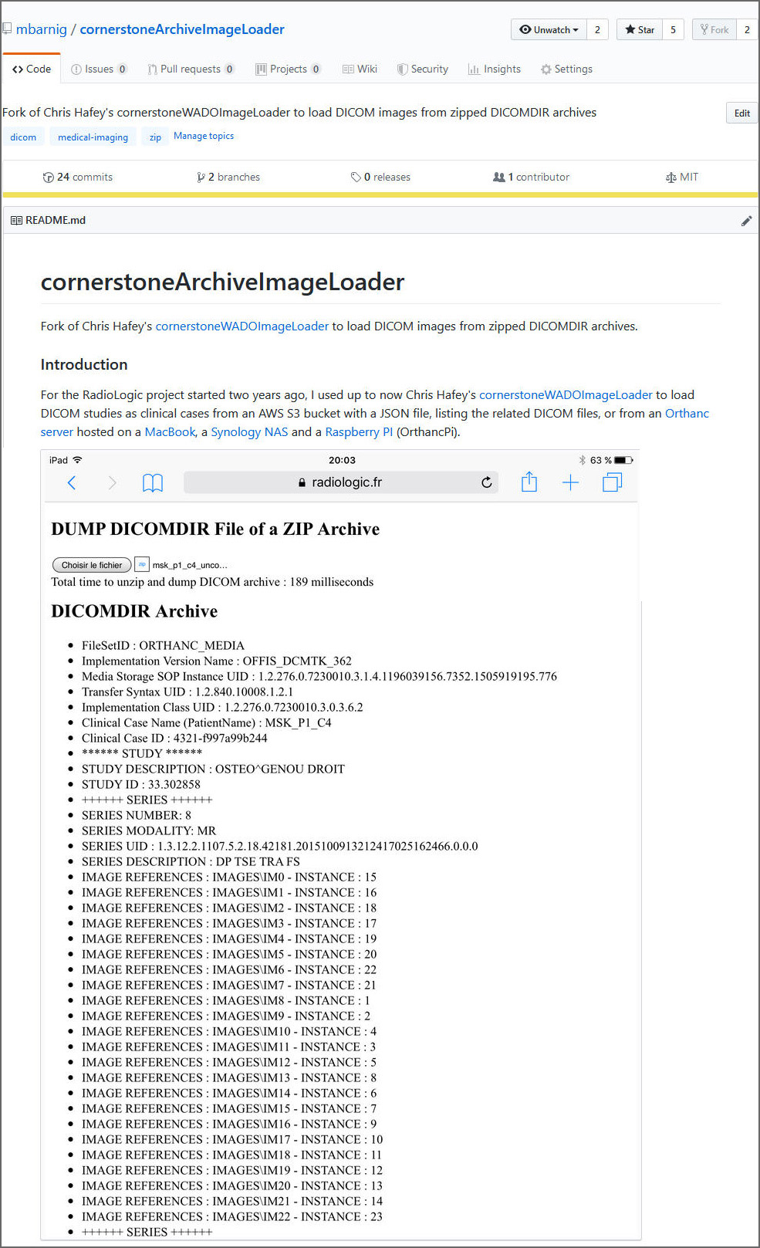
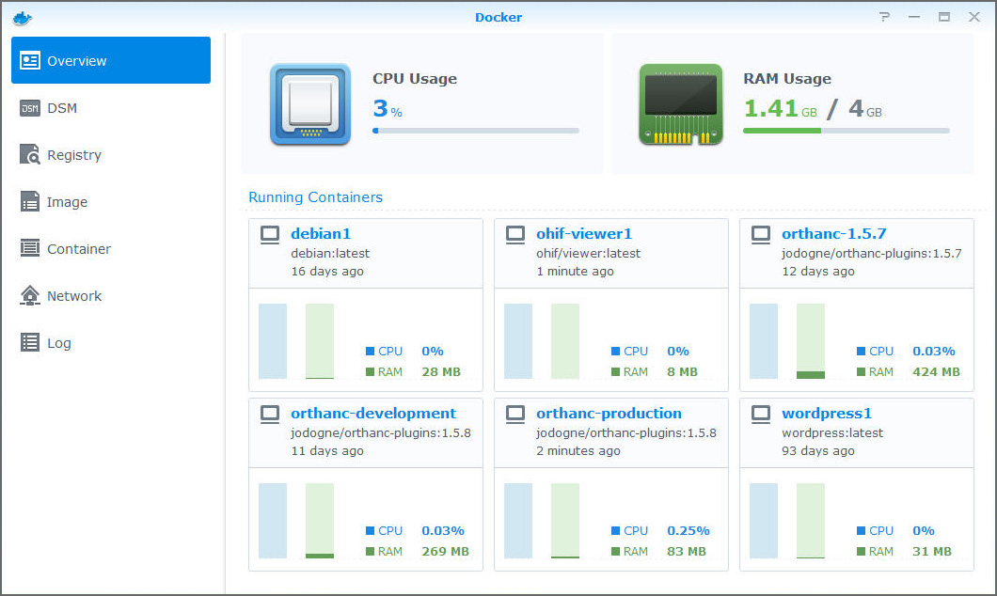
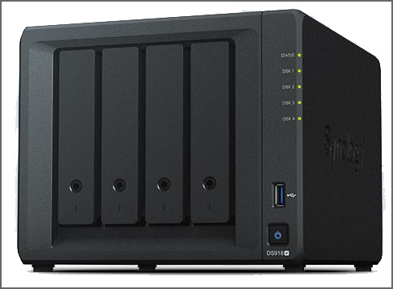
13. Improvements & Enhancements
In 2017, I looked for solutions to tackle the network issues:
CornerstoneArchiveImageLoader to store clinical cases in zipped archives inside the browser (new HTML5 technologies: indexedDB)
Installation of Orthanc inside a Docker container
Replacement of the MacBook, used from time to time as Orthanc server, by dedicated hardware: Synology diskstation

Slide 15
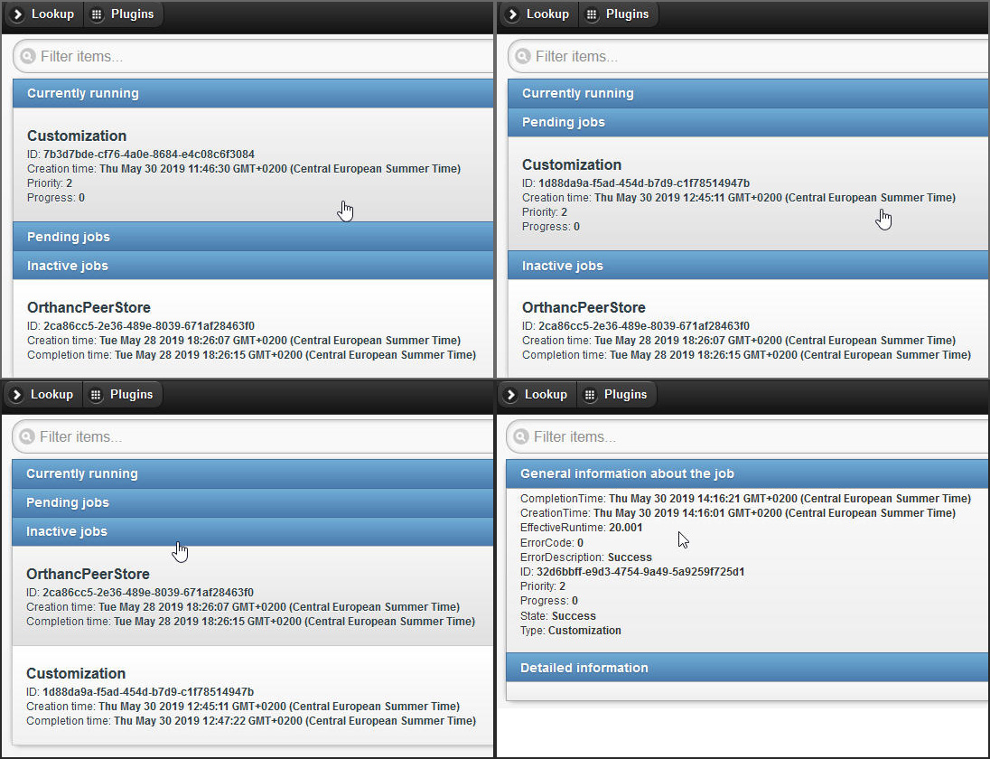
14. The last mile
After RadioLogicTutor, RadioLogicArchive was the second component of the RadioLogic system which was ready for a real-life deployment. The last component, RadioLogicCreator, was still waiting for improvement.
In July 2018, version 1.4 of Orthanc was released including a new advanced job engine and new metadata options. I was convinced that a plugin, using asynchronous jobs to create clinical cases, would solve all remaining problems, at least most of them.

Slide 16
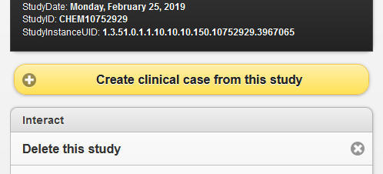
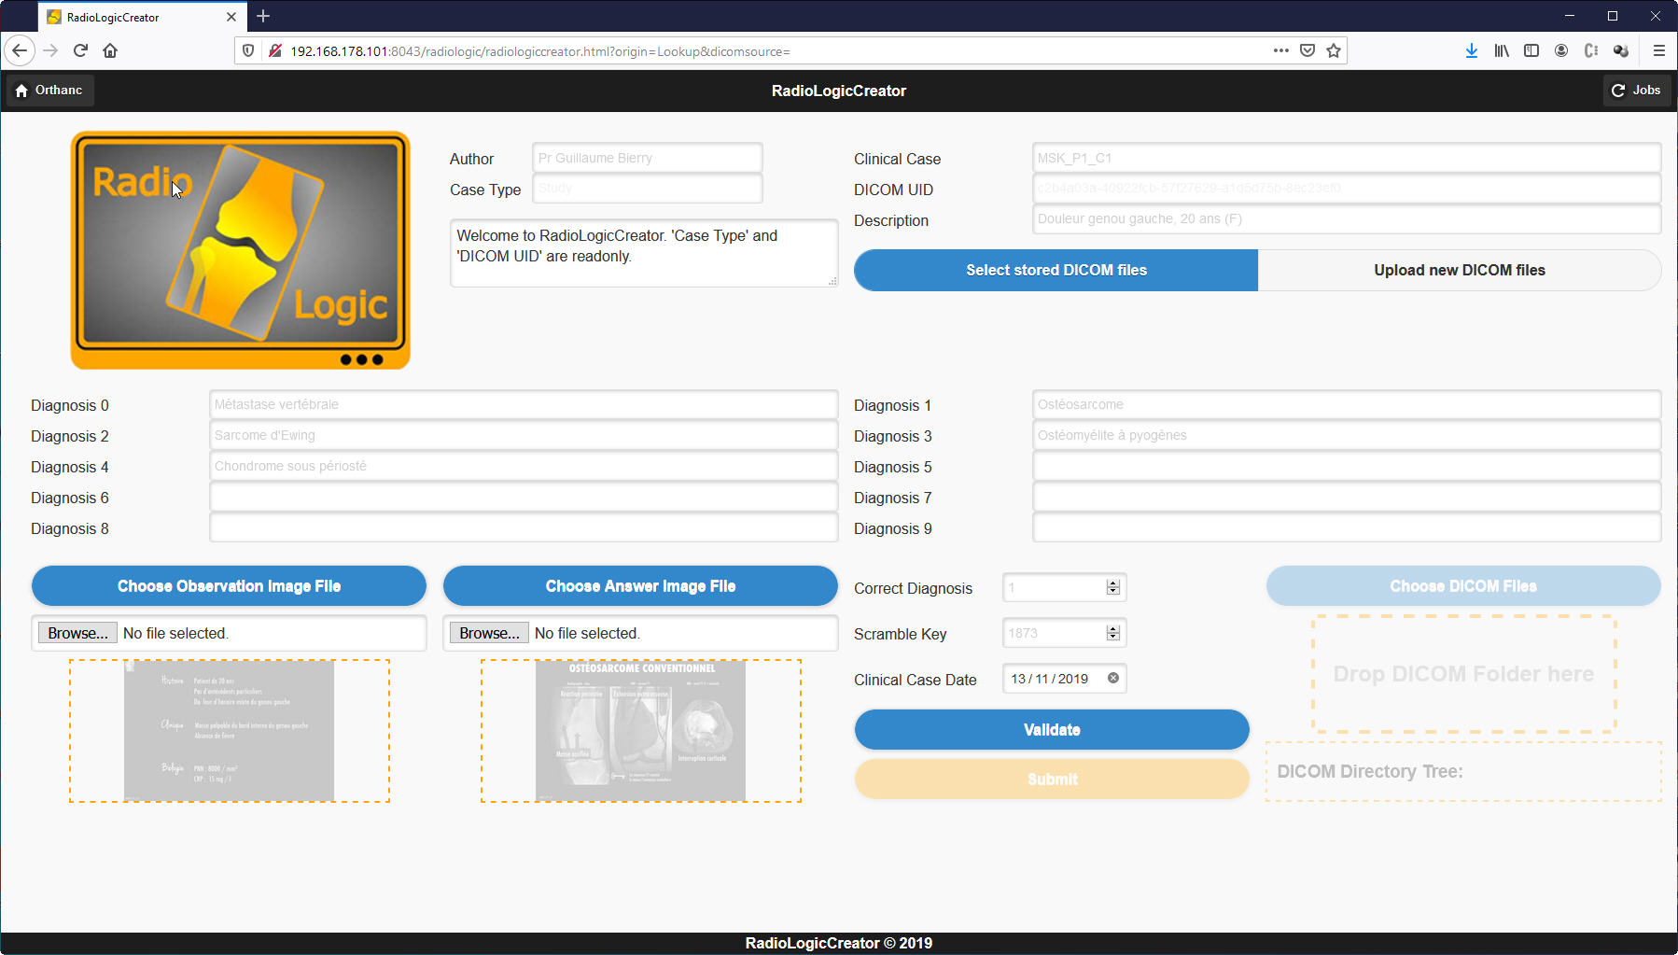
15. RadioLogicCreatorPlugin
HTML5 - Javascript webpage in the colors and style of the Orthanc explorer
Similarity with the RadioLogicCreator OS X tool
Creation of clinical cases with added Orthanc buttons
Drop zone to upload external DICOM files recursively

Slide 17
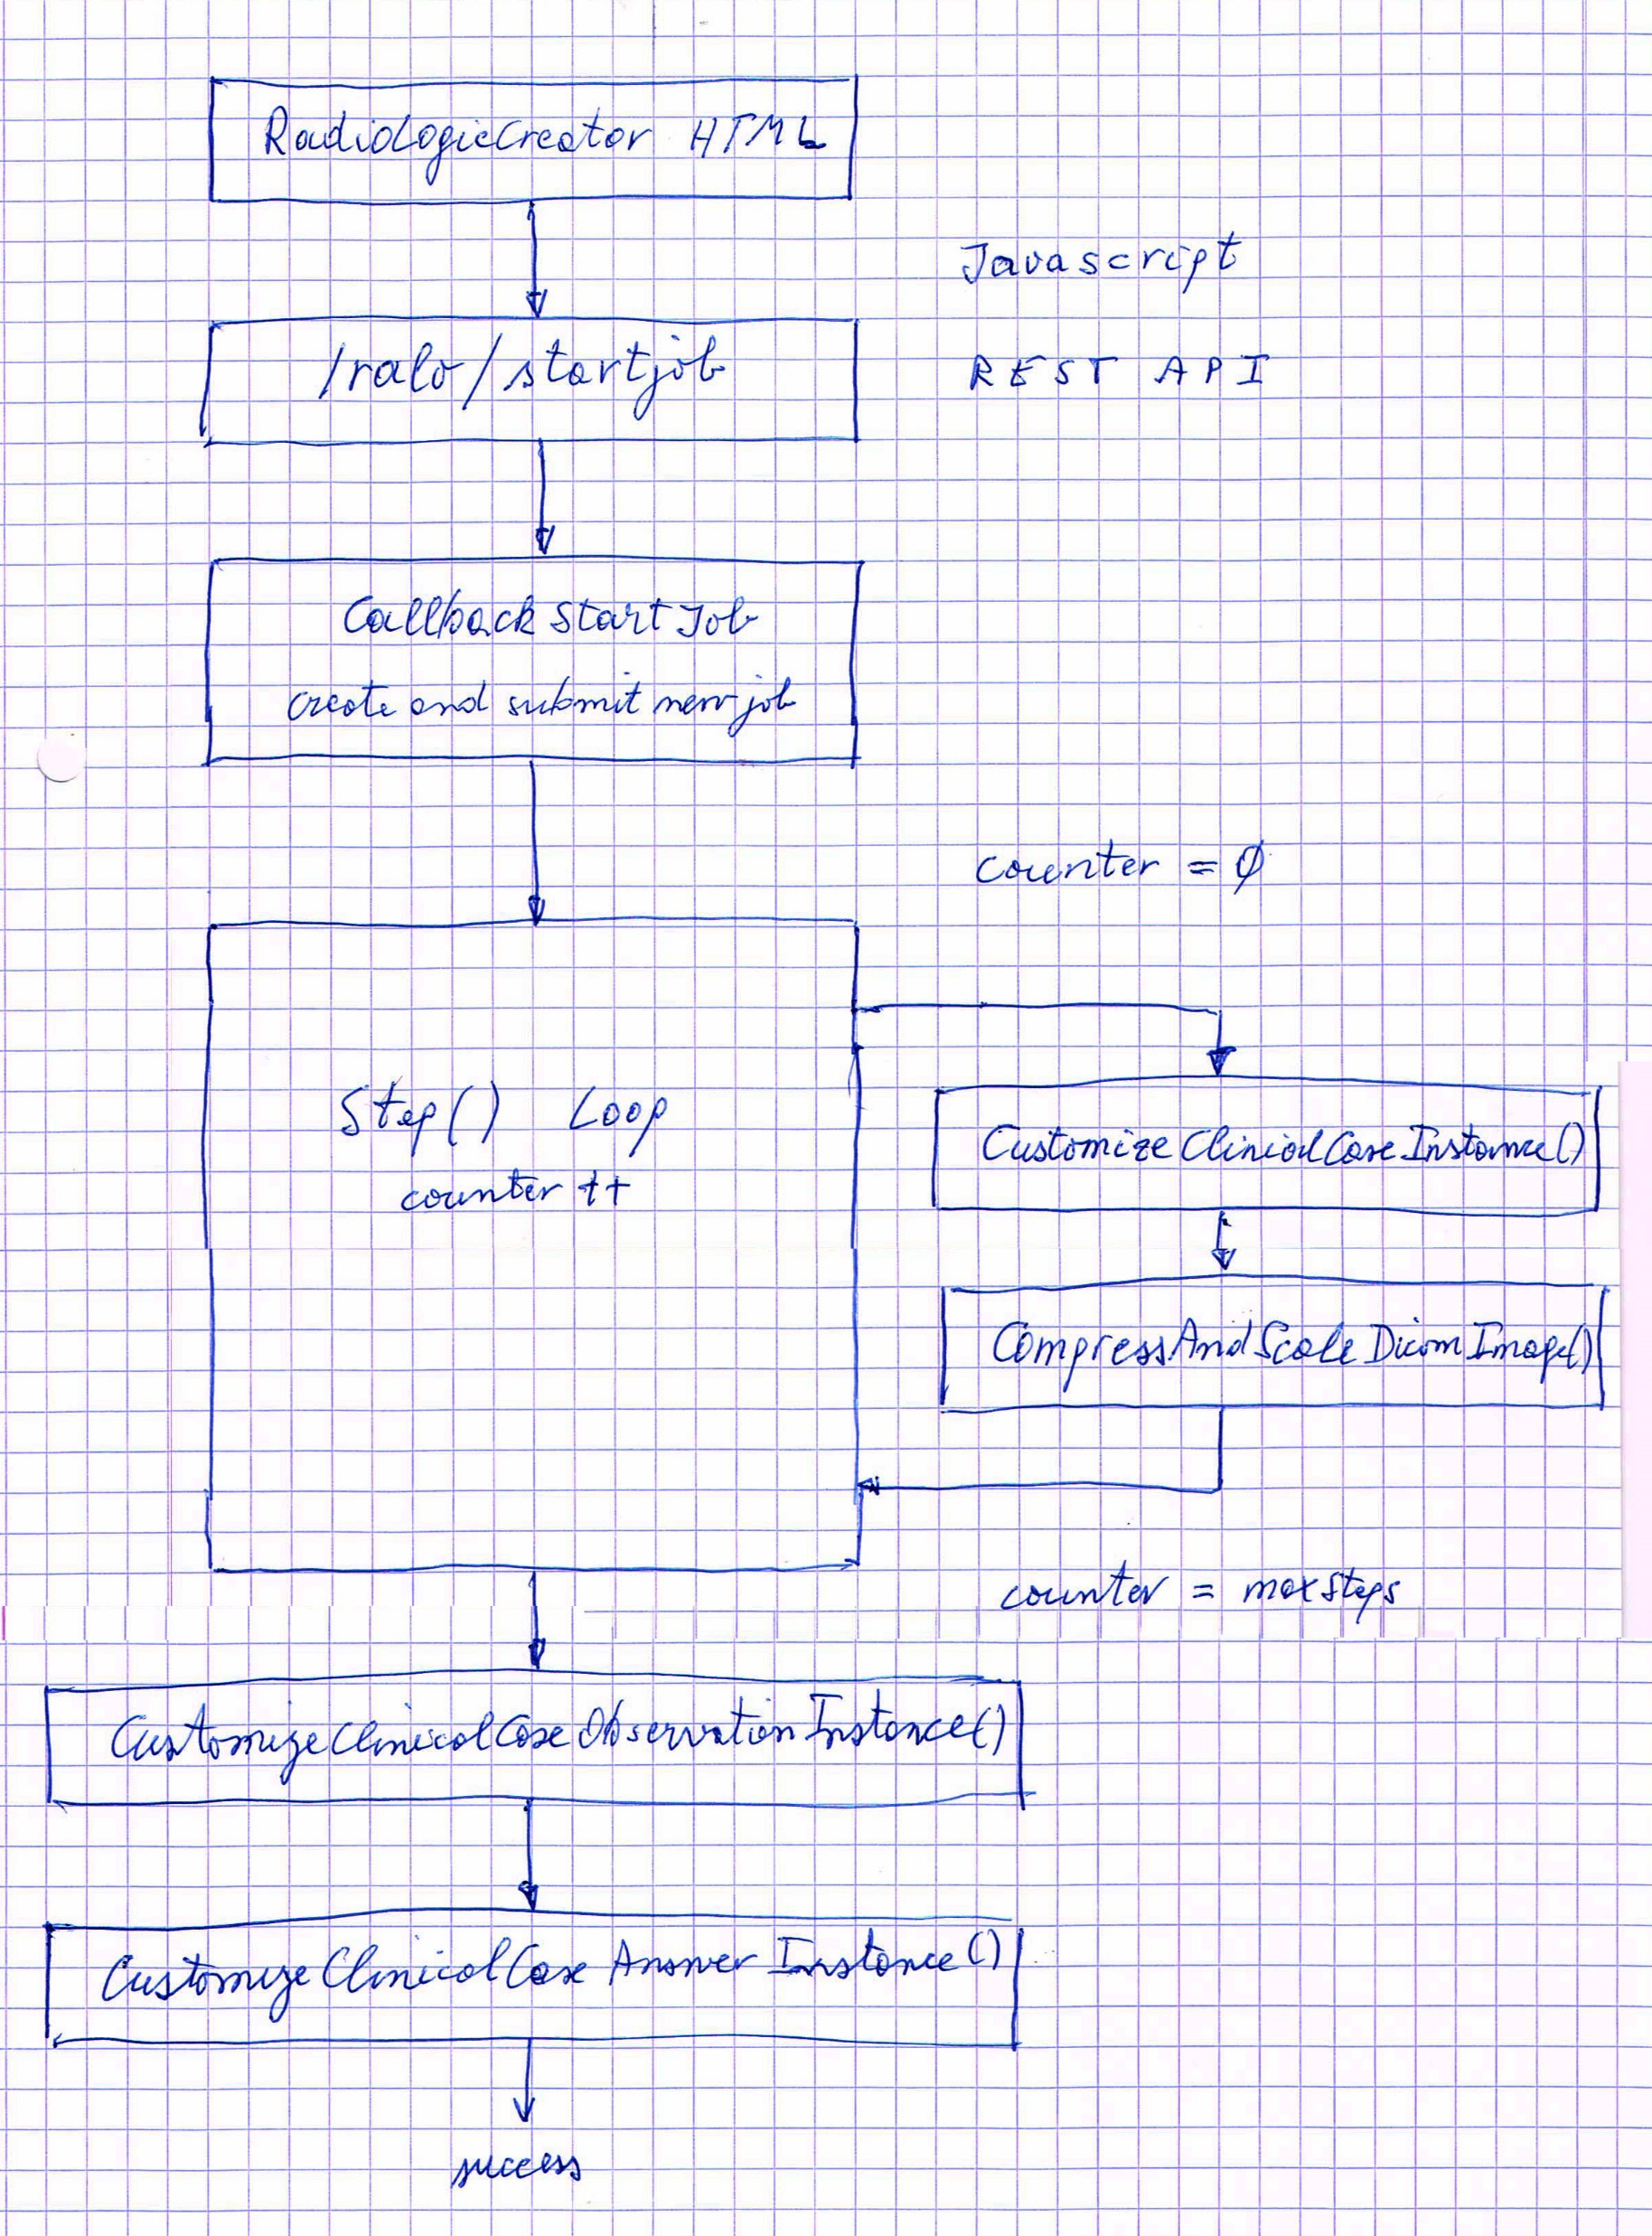
16. Plugin Functions I
The program code of the plugin is a mix of the following elements:
Orthanc SDK functions (from the modules Toolbox, Orthanc, Callback and REST)
Members of the Orthanc C++ wrapper class
Specific C++ functions
Main functions:
CallbackStartJob()
RadioLogicCreator::Step()
CustomizeClinicalCaseInstances()
CompressAndScaleDicomImage()
CustomizeClinicalCaseObservationInstance()
CustomizeClinicalCaseAnswerInstance()

Slide 18
17. Plugin Functions II
The Step() function works in the following three states by checking and incrementing the value of the member variable counter:
counter == 0 : the member variable maxSteps is set to the number of instances to process. The anonymization and customization of the instances is prepared and the function CustomizeClinicalCaseInstances() is called a first time. The job information content is initialized. The counter is incremented and the Step() function returns with "continue“.
0 < counter < maxSteps : CustomizeClinicalCaseInstances() and CompressAndScaleDicomImage() are called at each step by passing the related instanceId. The job content is regularly updated. If the CustomizeClinicalCaseInstances() returns an error, the Step() function returns with "stop" (failure), otherwise with "continue“.
counter == maxSteps : CustomizeClinicalCaseInstances() and CompressAndScaleDicomImage() are called a last time, followed by calling CustomizeClinicalCaseObservationInstance() and CustomizeClinicalCaseAnswerInstance(). If everything works fine, the Step() function returns with "success“.

Slide 19

18. Plugin Functions III
CustomizeClinicalCaseObservationInstance() and CustomizeClinicalCaseAnswerInstance() add the possible diagnoses and other data as private tags into the stored DICOM files. Due to issue 140 with Orthanc core, it is not possible to insert or modify private tags inside the Orthanc REST API's "/create-dicom" and “/modify". As a workaround I use a DICOM template with empty private tags, replace the pixels in the template with the data of the observation and answer image-files and modify these templates with a system call to the Offis DCMTK tool “dcmodify”.
The answer picture and the correct diagnosis are scrambled with javascript before the upload to the server to prevent clever users looking at the results before submitting their own diagnosis in RadioLogicTutor. The whole scrambling process is not hacker proof, but I think that encrypting the answers with public-key cryptography would be design-overkill.

Slide 20

19. Learning with quizzes
The Orthanc ecosystem and the presented RadioLogic tools are not limited to store, to view and to assess knowledge to interpret medical images.
Technically we can use pictures presenting any real-world problem with a related question and use DICOM tags, or Orthanc metadata, to store the correct answer.
A simple example is an e-learning quizz. Such quizzes are widespread on the Internet and related to all sort of topics : IQ tests, STEM (science, technology, engineering, mathematics) education, general knowledge, trivia or even fun. The answer types of these quizzes could be multiple-choice, true-false or open-ended.

Slide 21
20. Conclusions
I close my presentation with a few personal conclusions:
A project which evolved from a minimum viable project in 2012 to an outstanding open-source ecosystem and gave birth to a university spin-off, which occupies now more than 12 qualified people, is a great success story. Congratulations to Sébastien Jodogne for creating Orthanc and co-founding Osimis.
A large project related to advanced technologies takes three times more resources and time than the initial estimation, due to the appearence of non-expected issues.
The interest in new technologies can turn into addiction.
Thank you for listening.

